Slide 1
Application Design for Data Visualization in a Real-Time Power Prediction System with Weather Metrics Integration Llanes, RizzAH GRACE SAMBO, JULIUS JAY Thesis Adviser: MACABEBE, Erees Queen Master Student Consultants:CREAYLA, CHristine May and garcia, felan carlo

Slide 2

The Global Conondrum
Globally, investments on renewable energy has been rising as a response to depleting fossil fuel reserves, and as a response to climate change
Spending has been focused on the optimization of currently available platforms, and increased ease of use and market adoption
Notes:
Good afternoon, everyone. I am Rizzah Llanes and this is Julius Sambo and we are here to present our thesis proposal entitled “Application Design for Data Visualization in a Real-Time Power Prediction System with Weather Metrics Integration.”
The Philippines is developing in terms of technological innovations, and environmental studies. These studies aim to improve the living conditions of the Filipino people. Among these promising fields is the utilization and innovation of solar energy to provide electricity with minimal harm on the environment. Solar power plants and Photovoltaic Systems have already been built to contribute to the grid like the power plant found in San Carlos, Negros Occidental which provides 80 gigawatts hours per year to the Visayas grid or the Catalagan Solar Farm which has 200,000 solar panels and currently provides 63.3 megawatts to the entire western Batangas area. Private companies like Solaric and United Solar are also providing solar panels installations for residential use.

Slide 3

The PH Context
In the Philippines, the renewable energy sector is booming. With the country’s solar irradiance average being around 70% higher than in countries 5kWh/m2/day compared to Japan’s 3.75kWh/m2/day or Germany’s 2.71kWh/m2/day, there is a big solar potential.
The evidence being the increase in solar power plant installations.
Notes:
http://equatorenergypinoy.com.ph/statistics-economics-and-politics-of-solar-energy-in-the-philippines/

Slide 4

Why Bother With Solar
Despite these benefits, global adoption of solar power in private homes and in businesses has not reached its full potential.
In a study by Kinnear, et al, it has been shown that as one becomes more familiar with the innovation, it becomes more attractive to them.
Knowing about how a solar home installation saves them money, helps in increased adoption.
Notes:
https://scholarworks.iu.edu/dspace/bitstream/handle/2022/178/wp98-01B.html?sequence=1&isAllowed=y

Slide 5
Data Viz Biz
In order to make a web and mobile application that encourages the use of solar installations in homes and businesses, it is necessary to display information that is relevant and benificial to end users.
In this study, we will focus on two such parameters: weather conditions and power production and usage.
Notes:
https://scholarworks.iu.edu/dspace/bitstream/handle/2022/178/wp98-01B.html?sequence=1&isAllowed=y

Slide 6
Data Viz Biz
Inclusion of power generation and production allows users to visualize their savings, while inclusion of weather statistics allow them to learn what parameters affect production
Notes:
https://scholarworks.iu.edu/dspace/bitstream/handle/2022/178/wp98-01B.html?sequence=1&isAllowed=y

Slide 7
The Problem
Development and optimization of of Photovoltaic systems for household use is an increasing industry in the Philippines. With this, there is a need to provide visual presentation of data that is comprehensive, simple and accessible to consumers.
Notes:
Statement of the problem:
As the development and optimization of Photovoltaic systems for household use as an industry in the Philippines increases, there is a need to provide visual presentation of data from the systems. This display must be comprehensive, simple and accessible to members of the household. With the use of available weather data, a prediction algorithm for their system’s power generation can be developed and made available. The household can then be equipped with knowledge to better manage and plan their energy consumption.

Slide 8
OBJECTIVES
Install and modify a weather station with an integrated data server for real-time energy data monitoring.
Design a web and mobile application for a Real-Time Weather and Energy Monitoring System.
Use the integrated weather metric-based power prediction algorithm to provide the household with information they can use for energy management
Notes:
The main goal of our study it to provide a user-friendly platform for the household to receive useful information from their energy monitoring system and to enable users to make sound decisions related to their energy consumption. In order to achieve this, we are going to:

Slide 9
OBJECTIVE #1
Design a web and mobile application for real-time Weather Meter data.
a. Prepare weather station set-up
b. Interface web server with the weather station
c. Verify real-time data integrity
Notes:
The main goal of our study it to provide a user-friendly platform for the household to receive useful information from their energy monitoring system and to enable users to make sound decisions related to their energy consumption. In order to achieve this, we are going to:

Slide 10
OBJECTIVE #2
Design a web and mobile application for the Real-Time Weather and Energy Monitoring System.
a. Create wireframes for the web and mobile applications
b. Develop web and android applications for real-time weather and energy monitoring data
c. Perform user validation regarding the ease of use of the applications
d. Refine and reiterate applications based on user feedback
Notes:
The main goal of our study it to provide a user-friendly platform for the household to receive useful information from their energy monitoring system and to enable users to make sound decisions related to their energy consumption. In order to achieve this, we are going to:

Slide 11
OBJECTIVE #3
Integrate the algorithm of the Power Prediction Analytics
a. Gather historical energy generation and consumption data for power prediction and analytics.
b. Display simulated power generation and consumption and corresponding predicted household electric bill
Notes:
The main goal of our study it to provide a user-friendly platform for the household to receive useful information from their energy monitoring system and to enable users to make sound decisions related to their energy consumption. In order to achieve this, we are going to:

Slide 12
SCOPE AND LIMITATIONS
The information used for the web and mobile applications comes from the Weather Station setup located in the Faura Hall rooftop and PLDT-CTC Building rooftop. This setup measures the rainfall, wind speed, and wind direction parameters. It is located within the same area of the solar panel setup with no visible obstructions that could alter the data gathered.
For the power systems component, previously avialable data from a sytem already in place was used.

Slide 13
Methodology

Slide 14
Weather Station
The Sparkfun SEN – 09842 weather station measures three parameters: wind speed, wind direction, and rainfall
The set-up contains no active electronics and instead uses sealed magnetic reed switches and magnets in order to obtain the weather metrics. As data pin-outs to facilitate data collection, RJ-11 cables are provided for each data sensor.
Notes:
In order to facilitate weather data collection, a weather meter will be installed. The weather meter setup is developed by Sparkfun with product code SEN - 09842. The weather station contains measures three parameters, namely, wind speed, wind direction, and rainfall. The set-up contains no active electronics and instead uses sealed magnetic reed switches and magnets in order to obtain the weather metrics. As data pin-outs to facilitate data collection, RJ-11 cables are provided for each data sensor.

Slide 15
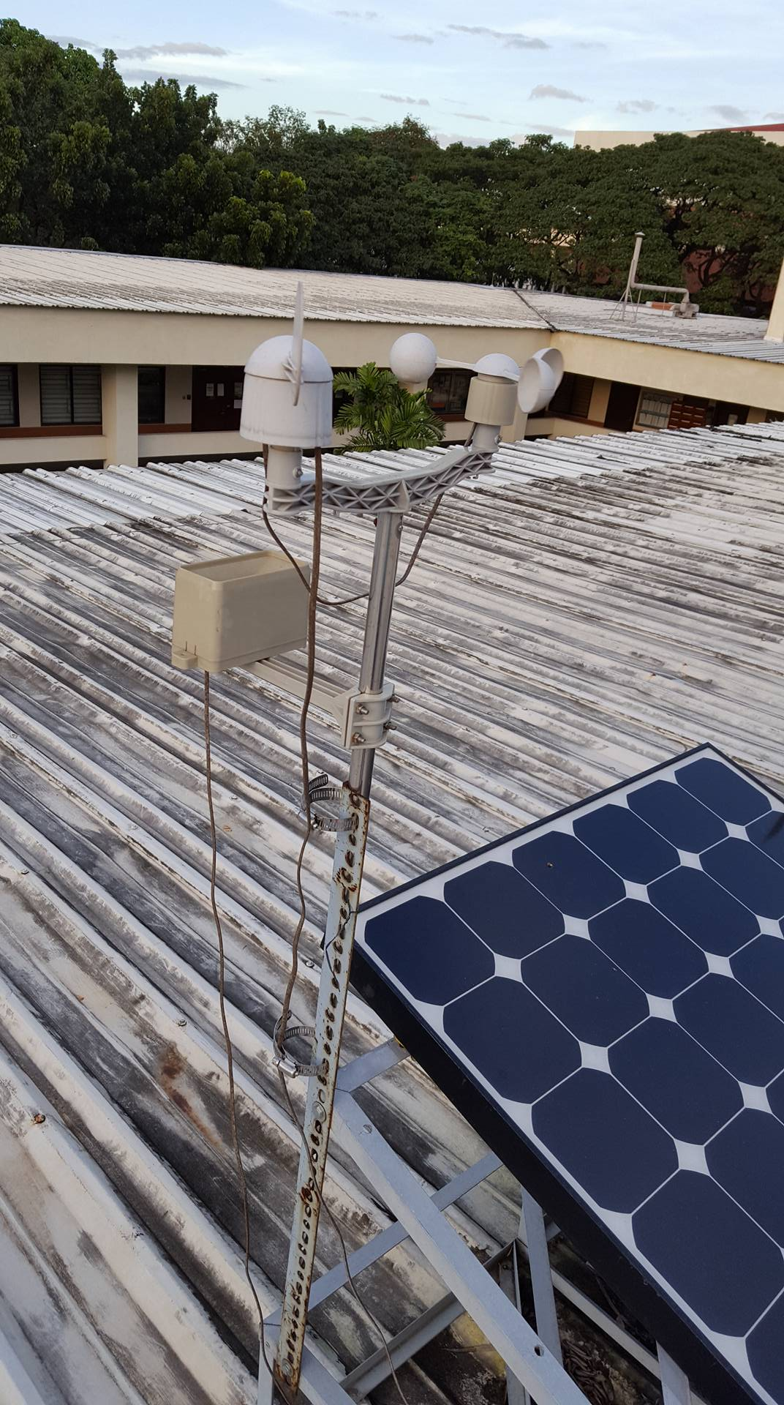
Rainfall sensor: tipping bucket, activates and clicks every 0.011 inches of rain collected
Wind speed sensor: anemometer, speeds of 1.492MPH equate to one switch closure per second
Wind direction sensor: voltage divider, 16 different directions
Weather Station
Notes:
The rainfall sensor is in the form of a self-emptying tipping bucket that activates and clicks once the container collects 0.011 inches of rain which is then emptied for the next data collection cycle, this creates a contact closure which can be recorded by a microcontroller connected to it. The wind speed sensor is an anemometer which measures data determined by switch closing once it achieves one full rotation. According to the data sheet, wind speeds of 1.492 MPH equate to one switch closure per second. The wind direction sensor’s data is based on the voltage produced by the resistors within the components of the sensor. There are eight switches within the component with each connected to a different sensor. Two switches may be closed at once to signify sixteen different positions. With this, a different voltage is produced and can be recorded corresponding to the different direction of the wind in degrees [12].

Slide 16
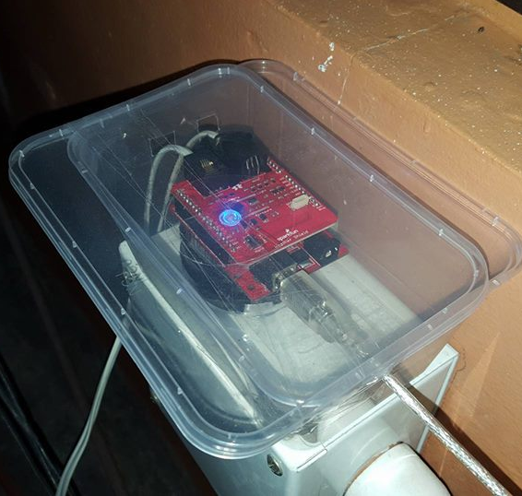
Weather Shield:
measures humidity and temperature using the HTU21D sensor, while barometric pressure is measured by the MPL3115A2 sensor. The weather shield also has provisions for connections to the weather sensor for rainfall, wind speed, and wind direction.
Weather Station
Notes:
Since the weather sensors only collected three weather parameters, a weather shield will be used to measure barometric pressure, relative humidity, and temperature. Luminosity is also one of the parameters measured by the weather shield, but it will not be used in the study. The humidity and temperature uses the HTU21D sensor, while barometric pressure is measured by the MPL3115A2 sensor. The weather shield also has provisions for connections to the weather sensor for rainfall, wind speed, and wind direction.

Slide 17
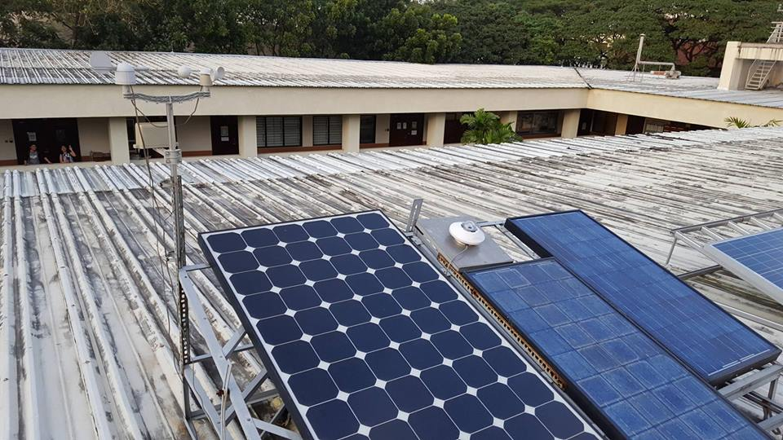
P H O T O
Weather Station

Slide 18
Interfacing, Raspberry Pi Server and Data Collection
Arduino Uno: Due to the weather meter’s lack of electronic components, the Uno will be used as the power source and to record incoming data. The Uno will gather the weather metrics from both the weather station and the shield and then transferred to the Raspberry Pi, which stores it to an SD card and makes the data available remotely via online access
Notes:
Due to the Sparkfun Weather Meters lack of electronic components, it has to have a voltage source, and be interfaced with a microprocessor, in order for it to measure and record incoming data. An Arduino Uno will be used as the microprocessor in this study. The weather shield will be connected to it, in order for pressure, humidity, and temperature to be recorded. RJ 11 connectors will be connected to the appropriate ports in the weather shield. The RJ 11 wires from the Weather Sensors will then be connected to the Weather Shield in order to complete the setup, and measure and record rainfall, wind speed, and wind direction parameters. The Arduino code for this set-up will be designed.
In order to accurately measure incoming data, the results obtained should be calibrated. In order to calibrate the rainfall sensor, 12 ml of water will be released for 10 intervals, with three trials. Wind speed and direction will be calibrated against the weather station in the Manila Observatory, as well as the parameters provided by the weather shield, temperature, pressure, and humidity.
Since the goal of the study is to develop a real time data visualization interface for the weather metrics collected by the weather station installed, data obtained by the set-up will be synchronized to a dedicated raspberry pi server. Through this server, back-end access will be established.

Slide 19
Integrating the Power Prediction Algorithm
The prediction algorithm that we will be adapting is based on a study being developed by Christine Creayla which utilizes the Random Forest Algorithm. The algorithm makes use of the weather data measured in the study, including rainfall, temperature, wind speed, wind direction, humidity, and pressure, to train the system in the process of predicting solar power output. The algorithm also uses historical solar irradiance and weather metric data to improve the accuracy of its results.
Notes:
The proponents of this study will create a back-end setup in the server that accesses the R-Pi collecting the data. The data collected will be stored in a database with their respective timestamps for historical purposes. Prior to storage, the data collected from the weather meter will be post-processed for the standard unit conversion. The applications that are to be made, for both Weather Meter and Power Prediction, will access the respective databases for the data needed. Fig. 2 and Fig. 3 show the flow chart representation of what the applications do at face value for the users.
JavaScript will be used as both the front-end and back-end programming language as this provides frameworks for making real-time charts through interfacing with websockets.

Slide 20
Review of Related LIterature

Slide 21
ON THE INVESTIGATION OF PV OUTPUT POWER REDUCTION DUE TO DUST ACCUMULATION AND WEATHER CONDITIONS This study focused on determining the effects of dust and weather conditions on the power generated by their Photovoltaic panels. They utilized a solar irradiance model, PV temperature model, and ARM Cortex-M4 microcontroller for their tests. Their results showed power output reductions in the following conditions:10.8% in the relative humidity of 52.24%40% during rainy conditions with humidity of 76.32%45% during cloudy conditions with 60.45%
Y. Zhongping, L. Weimin, G. Feng, W. Tao, Z. Gaili, W. Bin, “Integrated Wind and Solar Power Forecasting in China”, IEEE, 2013
Notes:
The rule-based model, a clear sky solar irradiance model that included solar position, and a PV temperature model were then used to estimate the PV output power, and tests were also conducted using an ARM Cortex-M4 microcontroller STM32F407 as a standalone digital controller equipped with voltage, current, temperature, and humidity sensors to measure real time PV output power. In this system, humidity was monitored to identify dusty, cloudy, and rainy conditions.

Slide 22
MINIMALISM IN DESIGNING USER INTERFACE OF COMMERCIAL WEBSITES BASED ON GESTALT VISUAL PERCEPTION LAWS The proponents of the study conducted a research-based investigation on the three top active websites in technology: Apple, Microsoft, and IBM. They used Gestalt rules and established a significant connection to the minimalist properties in a website. These laws and principles were then applied to the websites of the three companies, showing how minimalism greatly helped their website connect to their audience.
C. Wan, J. Zhao, Y. Song, Z. Xu, J. Lin, Z. Hu, “Photovoltaic and Solar Power Forecasting for Smart Grid”, IEEE, 2015.
Notes:
The mentioned properties are: the key principle of less use, more effect through organized Gestalt perception, simplicity based on the law of similarity and proximity, removing additive elements through permanence law, making balance by using completion law and making a negative environment by informed use of Gestalt rule of shape relation.

Slide 23


W E A T H E R
Notes:
Various weather prediction and metrics visualization have already been developed in order to provide its users with an interpretation of the current and future atmospheric conditions, such as WeatherUnderground and AccuWeather. Weather Underground, provides real-time weather metrics through its online portal and mobile applications through the use of user contributed data from personal weather stations, alongside those provided by the local government such as the National Weather Service in the United States. The service provides current, historical, and predicted values for temperature, wind, and precipitation in daily and hourly formats [7]. AccuWeather provides data visualization of federally provided weather data by the National Weather Station in the United States, and by various national weather stations across the world [8]. There is, however, a lack of platforms that integrates weather metric visualization, solar power production, and power management. In this review of related literature and studies, the proponents of the study provide selected studies on power management systems, solar collection and weather metrics prediction, and weather data visualization. These studies will serve to provide considerations in the design and development of the web and mobile applications. Other than that, these will also include published works on programming protocols and frameworks in order to aid them in the development process. These studies will also show the various motivations that contributed to them developing it.

Slide 24
Weather Station
The SEN – 09842 weather station is capable of measuring rainfall, wind speed, and wind direction, while the weather shield measures humidity, barometric pressure, and temperature.
It has been shown that high temperature values, has some correlation, while relative humidity, precipitation potential, shows high correlation in terms of solar irradiance, making the measurement of these parameters essential.
Y. Zhongping, L. Weimin, G. Feng, W. Tao, Z. Gaili, W. Bin, “Integrated Wind and Solar Power Forecasting in China”, IEEE, 2013
Notes:
Personal weather stations are systems that are made for personal or business use containing sensors that measure and collect weather metrics, mainly temperature, humidity, pressure, rainfall, wind speed, and wind direction. Personal weather stations can be procured commercially and may come in differing configurations containing additional sensors and circuitry [9]. In this study, a setup making use of an SEN – 09842 Sparkfun weather station and a Sparkfun weather shield were used. The SEN – 09842 weather station is capable of measuring rainfall, wind speed, and wind direction, while the weather shield measures humidity, barometric pressure, and temperature. It has been shown that high temperature values, has some correlation, while relative humidity, precipitation potential, shows high correlation in terms of solar irradiance, making the measurement of these parameters essential [11].

Slide 25
Solar Irradiance Forecasting Model
Solar irradiance values correlate with PV power production making their prediction valuable in making PV power production forecasts.
Solar irradiance is reliant on the atmospheric conditions, allowing meteorological data to be used as inputs in forecasting models and use machine learning algorithms to provide a forecasting model to perform next-day forecasting of PV Power production.
C. M. C. Creayla, F. C. C. Garcia, and E. Q. B. Macabebe, “Solar Irradiance Forecasting Model Using Random Forest for Hybrid Photovoltaic Systems.”
Notes:
Solar irradiance values correlate with PV power production making their prediction valuable in making PV power production forecasts. Solar irradiance is reliant on the atmospheric conditions, allowing meteorological data to be used as inputs in forecasting models. Using machine learning algorithms, and parameters such as temperature, humidity, pressure, wind speed, wind direction, as well as the date and time, a forecasting model with an accuracy of 87.04% was developed making it possible to perform next-day forecasting of PV Power production [16].

Slide 26
Real-Time Energy Monitoring System
Real-time energy monitoring systems are platforms that track energy consumption, and provides users with energy management tools
For grid-tied PV installations, DC voltage, current, and power generation are considered from both the PV system and the grid to provide power generation versus consumption ratio
[G. C. Ngo, J. K. I. Floriza, C. M. C. Creayla, F. C. C. Garcia, and E. Q. B. MacAbebe, “Real-time energy monitoring system for grid-tied Photovoltaic installations,” IEEE Reg. 10 Annu. Int. Conf. Proceedings/TENCON, vol. 2016–January, pp. 1–4, 2016.
Notes:
Real time energy monitoring systems are platform that are able to track the energy consumption of the various household appliances of a consumer, providing them with their total consumption over time. These systems are also capable of providing users with energy management tools. In this project, a real-time energy monitoring system for grid-tied photovoltaic installations will be considered. This system measures the DC voltage, current, and power generated by the PV modules, and the total energy consumption of a given household from both the PV system and the grid. These parameters were used as the DC voltage, current, and power generated by the PV modules serves as the comparison point in determining the power generation versus power consumption ratio [15].

Slide 27
Results

Slide 28
Weather Meter Calibration
Rain Reading (direct wire) |  |  |  | Rain Reading (with extension)
Set number | 1st Trial | 2nd Trial | 3rd Trial | 1st Trial | 2nd Trial | 3rd Trial
1 | 0.04 | 0.07 | 0.07 | 0.07 | 0.07 | 0.05
2 | 0.11 | 0.13 | 0.13 | 0.13 | 0.13 | 0.12
3 | 0.18 | 0.2 | 0.2 | 0.2 | 0.2 | 0.19
4 | 0.23 | 0.26 | 0.26 | 0.26 | 0.26 | 0.25
5 | 0.29 | 0.32 | 0.33 | 0.33 | 0.32 | 0.32
6 | 0.35 | 0.39 | 0.39 | 0.41 | 0.39 | 0.39
7 | 0.43 | 0.45 | 0.45 | 0.47 | 0.45 | 0.45
8 | 0.5 | 0.51 | 0.52 | 0.54 | 0.51 | 0.52
9 | 0.56 | 0.59 | 0.58 | 0.61 | 0.57 | 0.58
10 | 0.63 | 0.66 | 0.65 | 0.67 | 0.64 | 0.65
Notes:
Palipat nito sa slide na may description nung calibration please ☺

Slide 29
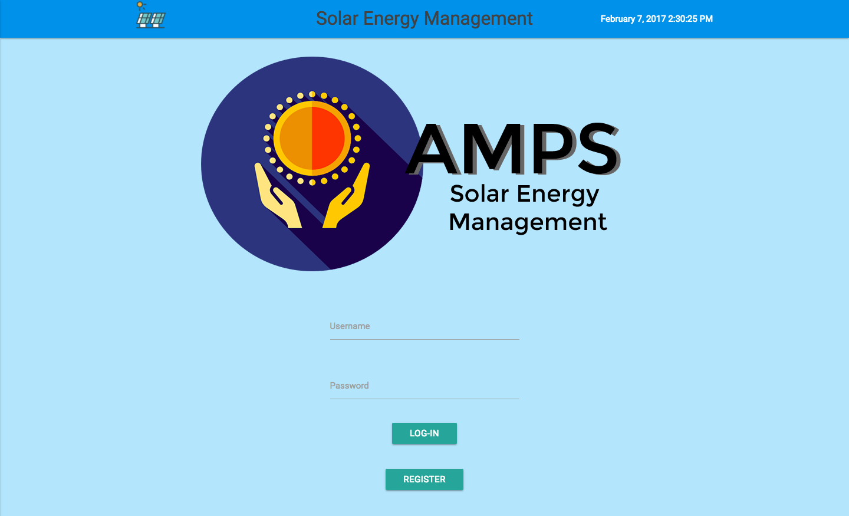

Slide 30
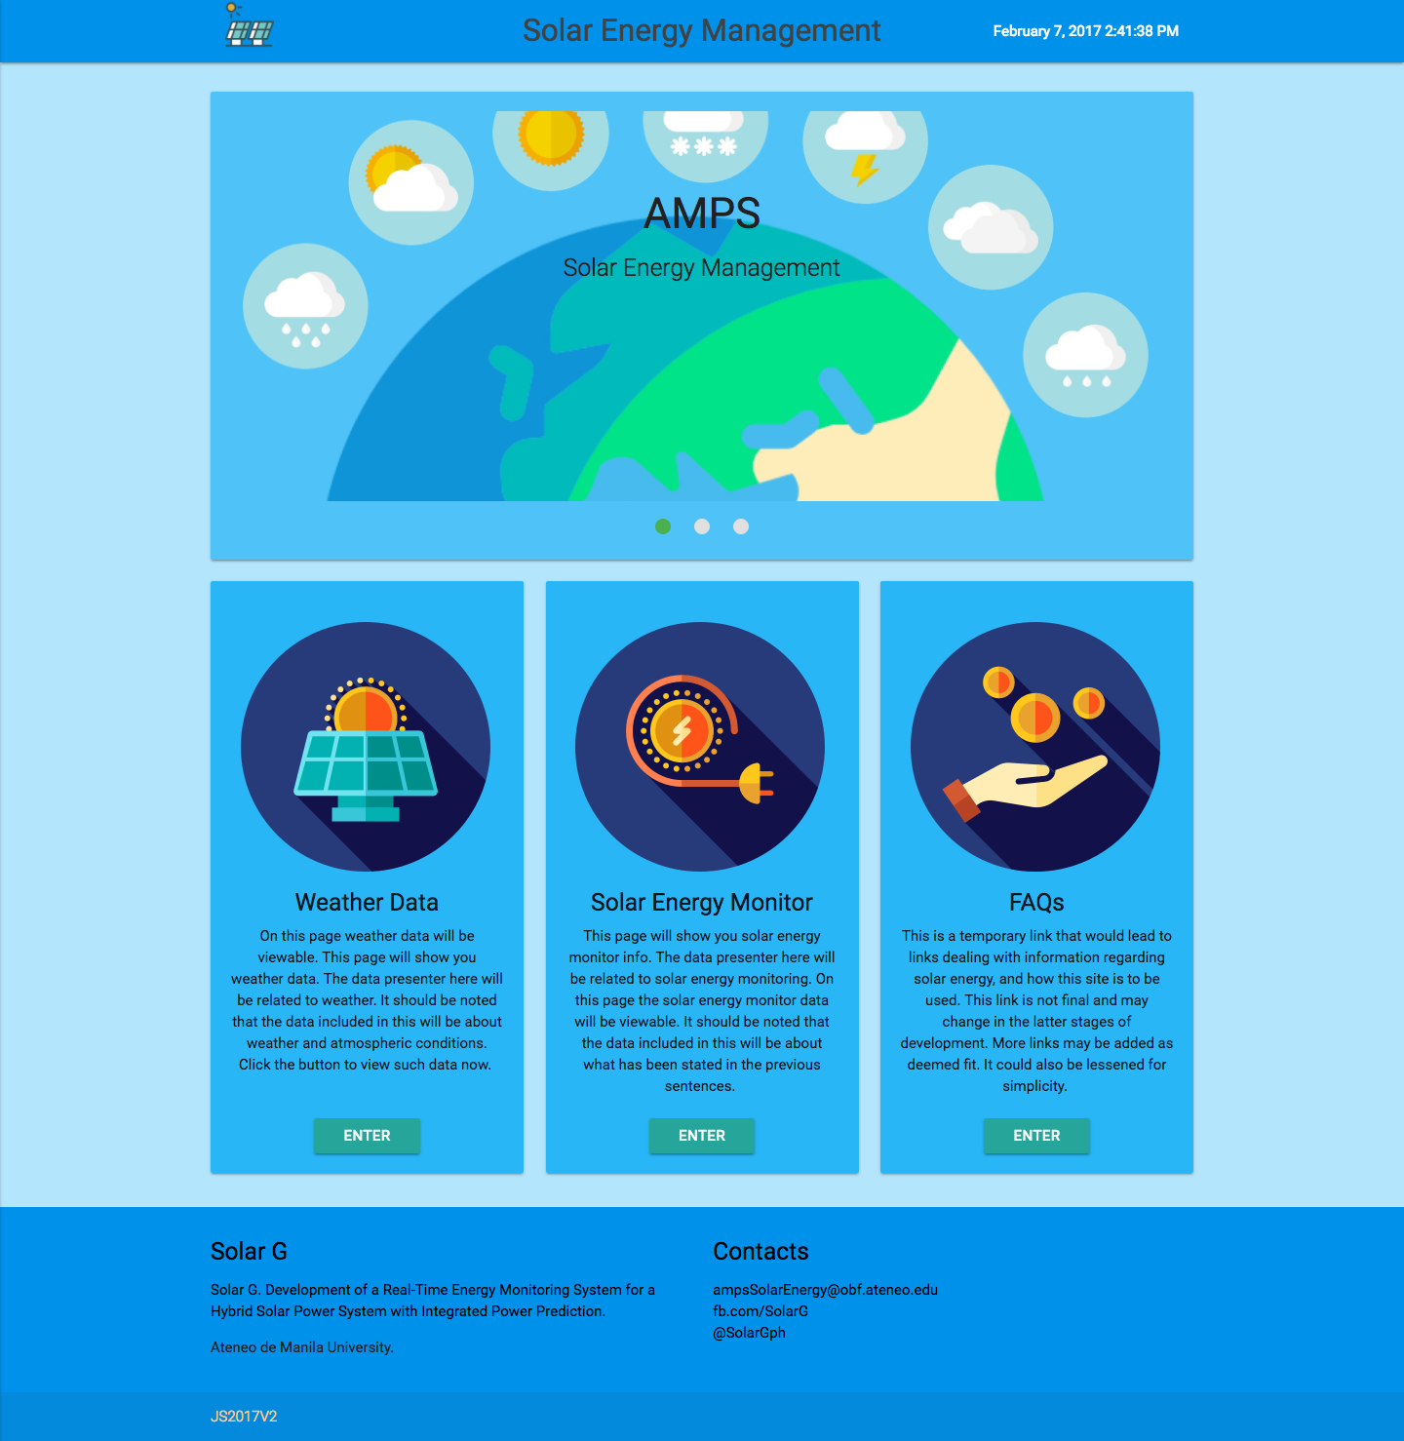

Slide 32
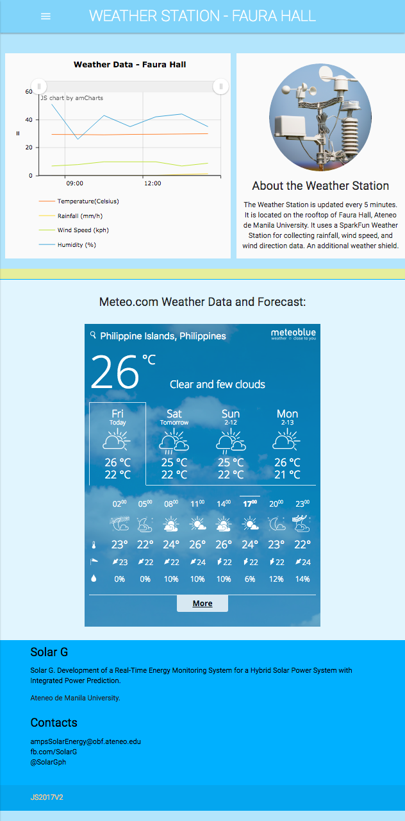

Slide 34
In order to quantify the usability of the website, the group conducted an surveys with both qualitative and quantitative questions based on usability.gov and the Website Accesibility Initiative or w3.org’s guidelines.
For the first version of the website, the main comments were on:
Color scheme (“too blue”)
Font usage (“cheap fonts”)
Linkages (“redirects to the wrong page”)

Slide 35
Landing Page Attractiveness | Main Page attractiveness | Weather Page attractiveness | Site Graphics | Graphics vs Text balance | Color Scheme | Typhography | Hompage makes me want to explore | Navigation | Getting to information | Information layering. | Readbility | Understandability | Information Density | Purpose | Overall Site Rating
8 | 9 | 7 | 9 | 8 | 8 | 7 | 8 | 7 | 7 | 8 | 8 | 8 | 8 | 8 | 8
9 | 9 | 8 | 10 | 8 | 7 | 7 | 7 | 8 | 8 | 8 | 9 | 9 | 9 | 9 | 8
9 | 9 | 8 | 10 | 10 | 10 | 8 | 8 | 8 | 8 | 9 | 9 | 8 | 8 | 8 | 9
10 | 10 | 10 | 10 | 10 | 10 | 10 | 10 | 10 | 10 | 10 | 10 | 10 | 10 | 10 | 10
10 | 10 | 10 | 10 | 10 | 10 | 10 | 10 | 10 | 10 | 10 | 10 | 10 | 10 | 10 | 10
8 | 8 | 8 | 8 | 8 | 8 | 8 | 8 | 8 | 8 | 8 | 8 | 8 | 8 | 8 | 8
6 | 7 | 8 | 7 | 7 | 3 | 3 | 8 | 10 | 9 | 8 | 7 | 8 | 7 | 10 | 6
8 | 7 | 6 | 8 | 7 | 6 | 7 | 8 | 8 | 8 | 8 | 8 | 7 | 7 | 8 | 7
8.5 | 8.625 | 8.125 | 9 | 8.5 | 7.75 | 7.5 | 8.375 | 8.25 | 8.5 | 8.625 | 8.625 | 8.5 | 8.375 | 8.875 | 8.25

Slide 36
Main areas needing improvement were:
Typography – 7.5
Color Scheme – 7.75
Weather Page – 8.125
Navigability – 8.25

Slide 37


Slide 40
For the second version of the site, the navigability was still the main point of contention, but there was an improvement on the comments on the overall design, being described as “better”, “content is clear and easy to understand”, and “organized”. The complaints now were regarding the images used being too western centric.

Slide 41
Landing Page Attractiveness | Main Page attractiveness | Weather Page attractiveness | Site Graphics | Graphics vs Text balance | Color Scheme | Typhography | Hompage makes me want to explore | Navigation | Getting to information | Information layering. | Readbility | Understandability | Information Density | Purpose | Overall Site Rating
9 | 9 | 8 | 9 | 9 | 9 | 10 | 9 | 9 | 9 | 9 | 9 | 9 | 9 | 9 | 9
10 | 10 | 10 | 10 | 10 | 10 | 10 | 10 | 7 | 8 | 9 | 9 | 9 | 9 | 9 | 9
9 | 8 | 8 | 10 | 9 | 9 | 9 | 9 | 8 | 9 | 9 | 9 | 8 | 9 | 8 | 8
6 | 4 | 7 | 7 | 6 | 7 | 6 | 6 | 9 | 9 | 9 | 9 | 7 | 8 | 9 | 7
10 | 9 | 9 | 8 | 8 | 9 | 9 | 10 | 10 | 10 | 10 | 8 | 9 | 9 | 9 | 9
9 | 10 | 9 | 10 | 10 | 10 | 10 | 10 | 10 | 8 | 5 | 7 | 10 | 4 | 5 | 8
7 | 5 | 6 | 6 | 9 | 6 | 6 | 6 | 5 | 8 | 6 | 10 | 7 | 9 | 10 | 7
10 | 10 | 10 | 7 | 10 | 10 | 10 | 10 | 10 | 10 | 10 | 10 | 10 | 10 | 10 | 9
9 | 6 | 8 | 10 | 9 | 10 | 7 | 9 | 10 | 9 | 8 | 8 | 6 | 9 | 9 | 8
9 | 8 | 10 | 9 | 9 | 10 | 9 | 7 | 6 | 6 | 7 | 7 | 8 | 9 | 10 | 8
8.83 | 8.33 | 8.5 | 9 | 8.67 | 9 | 9 | 9 | 8.83 | 8.83 | 8.5 | 8.5 | 8.67 | 8 | 8.17 | 8.33

Slide 42
Main areas needing improvement were:
Main Page – 8.33 (down from 8.625)
Information Density– 8 (down from 8.375)
Purpose – 8.17 (down from 8.625)
Main areas needing improvement during the first pass were:
Typography – up to 9 from 7.5
Color Scheme – Up to 9 from 7.75
Weather Page – Up to 8.5 from 8.125
Navigability – Up to 8.83 from 8.25

Slide 43

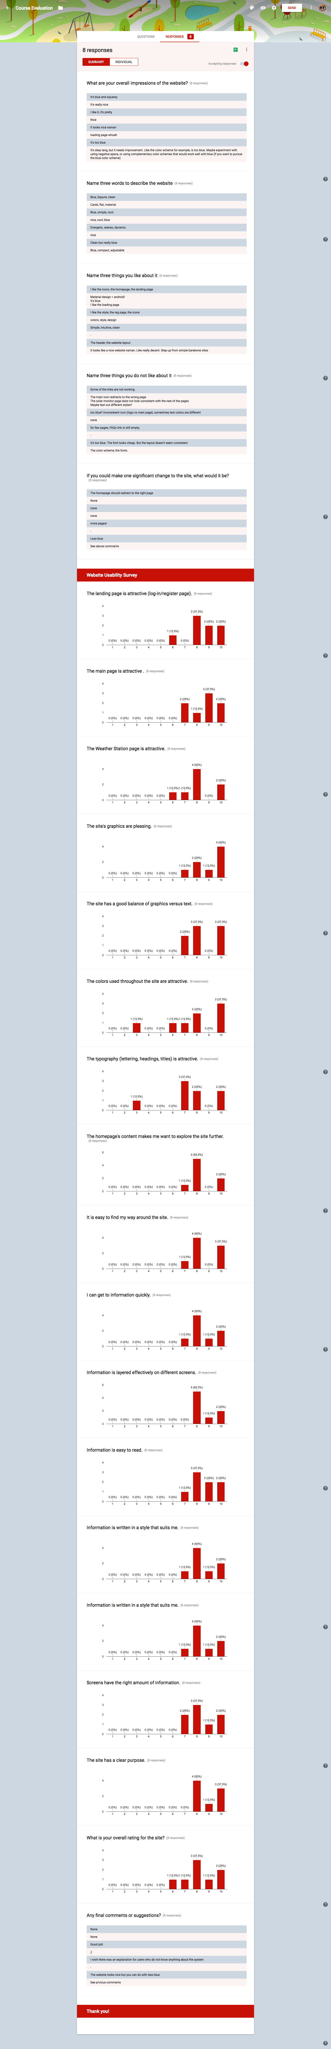
Notes:
Palipat nito sa slide na may description nung calibration please ☺

Slide 44
Notes:
Palipat nito sa slide na may description nung calibration please ☺

Slide 45
Notes:
Palipat nito sa slide na may description nung calibration please ☺

Slide 46
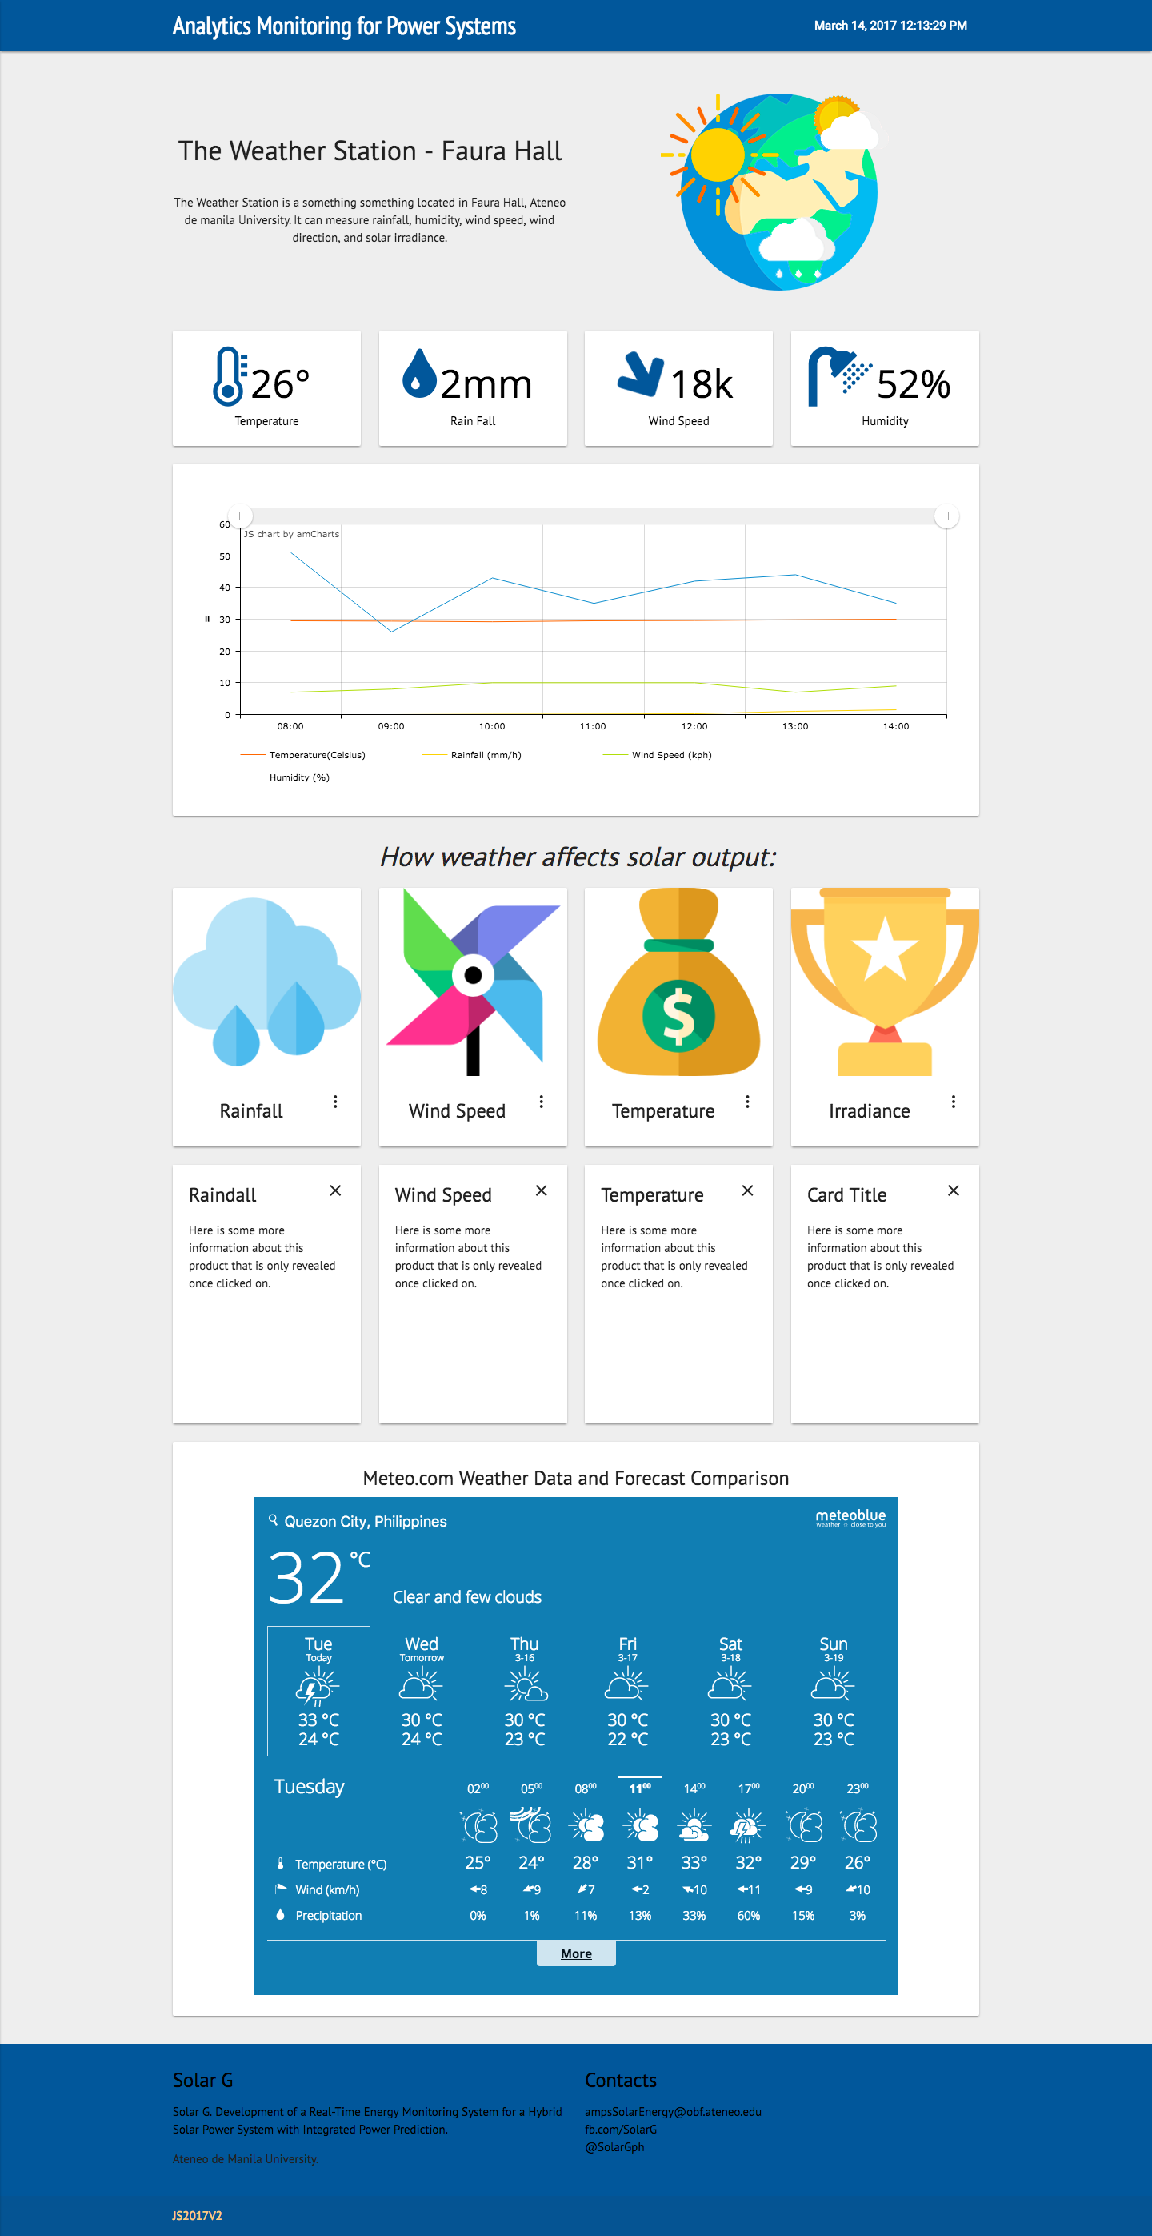
Notes:
Palipat nito sa slide na may description nung calibration please ☺

Slide 47
Notes:
Palipat nito sa slide na may description nung calibration please ☺

Slide 48

Notes:
Palipat nito sa slide na may description nung calibration please ☺

Slide 49
The Next Steps:
Further website iteration + survey (bigger sample size and more results)
Integrate server to site for real time data update
Recalibration of relocated w. station
Manuscript writing
Include a block diagram for the weather station set-up
Full integration of front & back-end
Replacing images with CC0 license
Finisih mobile version of the app
Notes:
Palipat nito sa slide na may description nung calibration please ☺

Slide 50
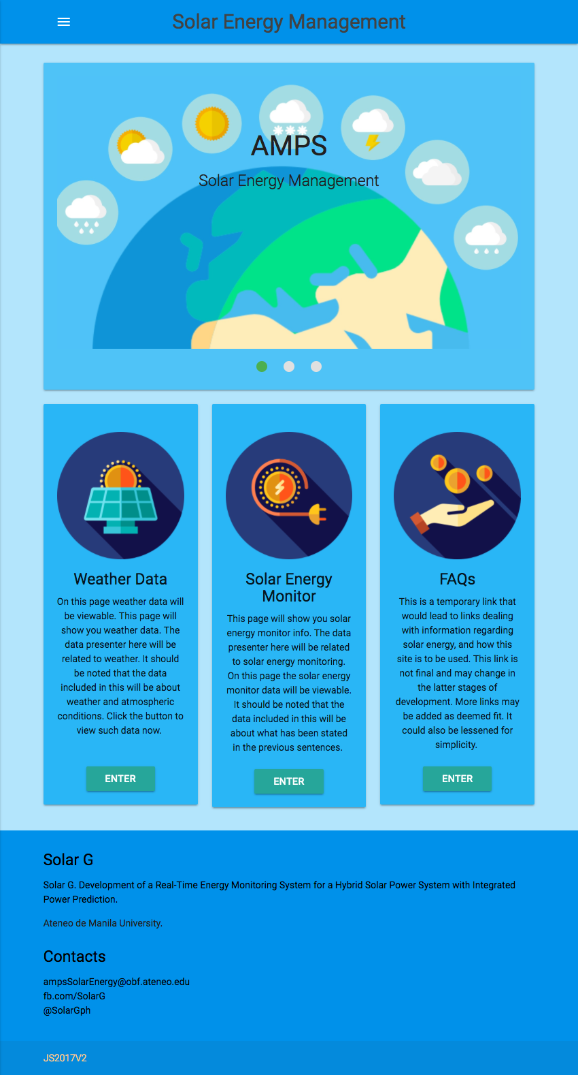
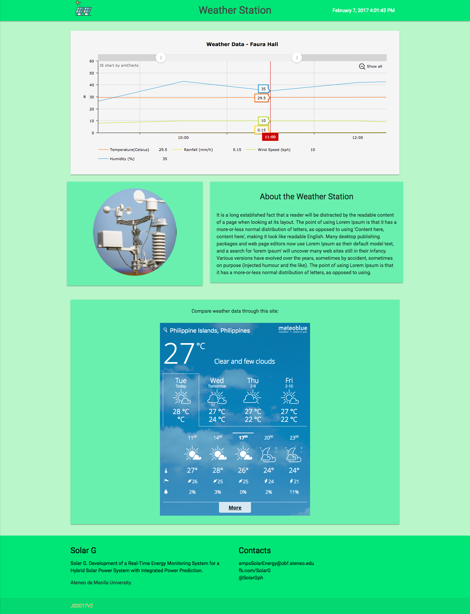
Notes:
Palipat nito sa slide na may description nung calibration please ☺

Slide 51
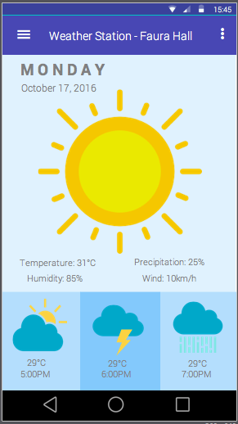

Slide 52
Thanks!
Application Design for Data Visualization in a Real-Time Power Prediction System with Weather Metrics Integration
Proponents:
Rizzah Grace Llanes
Julius Jay Sambo
Thesis Adviser: Erees Queen Macabebe
Master Student Consultant: Christine May Creayla and Felan Carlo Garcia
Gantt Chart

Slide 53
References
"59-MW solar power plant opens in Negros Occidental", CNN, 2016. [Online]. Available: http://cnnphilippines.com/regional/2016/04/19/sacasun-solar-power-plant-negros-occidental.html. Accessed: 25- Oct- 2016.
"PH largest solar farm up in Batangas", Technology.inquirer.net, 2016. [Online]. Available: http://technology.inquirer.net/46928/ph-largest-solar-farm-up-in-batangas. Accessed: 25- Oct- 2016.
"Solar Panels for Homes Pricing Options", SOLARIC Philippines, 2016. [Online]. Available: http://www.solaric.com.ph/solar-for-philippine-homes/. Accessed: 26- Oct- 2016.
"Residential Solar Power Installation Philippines | United Solar", www.unitedsolar.com.ph, 2016. [Online]. Available: http://www.unitedsolar.com.ph/residential/. Accessed: 26- Oct- 2016.
G. Chicco, V. Cocina, P. Di Leo, F. Spertino, “Weather forecast-based power predictions and experimental resuls from photovoltaic system.”, IEEE, 2014.
A. H. Faranadia, A. M. Omar, N. Syafiqah, S. Mohamed, “Prediction of Grid Connected Photovoltaic Power Systems Perfomance Using Mathematical Models”, IEEE, 2014.
"Weather Underground - About Us," in Weather Undergound. [Online]. Available: https://www.wunderground.com/about/our-company. Accessed: Oct. 26, 2016.
“About Us," in Accu Weather, AccuWeather. [Online]. Available: http://www.accuweather.com/en/about. Accessed: Oct. 26, 2016.
"What is a personal weather station," in Weather Underground, 2016. [Online]. Available: https://www.wunderground.com/weatherstation/whatispws.asp. Accessed: Oct. 26, 2016.
Y. Zhongping, L. Weimin, G. Feng, W. Tao, Z. Gaili, W. Bin, “Integrated Wind and Solar Power Forecasting in China”, IEEE, 2013
N. Sharma, P. Sharma, D. Irwin and P. Shenoy, "Predicting Solar Generation from Weather Forecasts Using Machine Learning", IEEE, 2011.
M. Fourati, W. Chebbi, A. Kamoun, “Development of a Web Based Weather Station for Irrigation Scheduling”, IEEE, 2014.
H. Saini, A. Thakur, S. Ahuja, N. Sharwal, “Arduino Based Automatic Wireless Weather Station with Remote Graphical Application and Alerts”, IEEE, 2016.
C. Wan, J. Zhao, Y. Song, Z. Xu, J. Lin, Z. Hu, “Photovoltaic and Solar Power Forecasting for Smart Grid”, IEEE, 2015.
G. C. Ngo, J. K. I. Floriza, C. M. C. Creayla, F. C. C. Garcia, and E. Q. B. MacAbebe, “Real-time energy monitoring system for grid-tied Photovoltaic installations,” IEEE Reg. 10 Annu. Int. Conf. Proceedings/TENCON, vol. 2016–January, pp. 1–4, 2016.
C. M. C. Creayla, F. C. C. Garcia, and E. Q. B. Macabebe, “Solar Irradiance Forecasting Model Using Random Forest for Hybrid Photovoltaic Systems.”
J. Giulio et al., “Designing effective feedback of electricity consumption for mobile user interfaces.,” PsychNology J., vol. 7, no. 3, pp. 265–289, 2009.
Argent Data Systems, "Weather Sensor Assembly p/n 80422,".
"Weather shield hookup guide," in Sparkfun. [Online]. Available: https://learn.sparkfun.com/tutorials/weather-shield-hookup-guide. Accessed: Oct. 26, 2016.
M. Rouse, "What is Prototyping model?,". [Online]. Available: http://searchcio.techtarget.com/definition/Prototyping-Model. Accessed: Oct. 26, 2016.

Slide 54
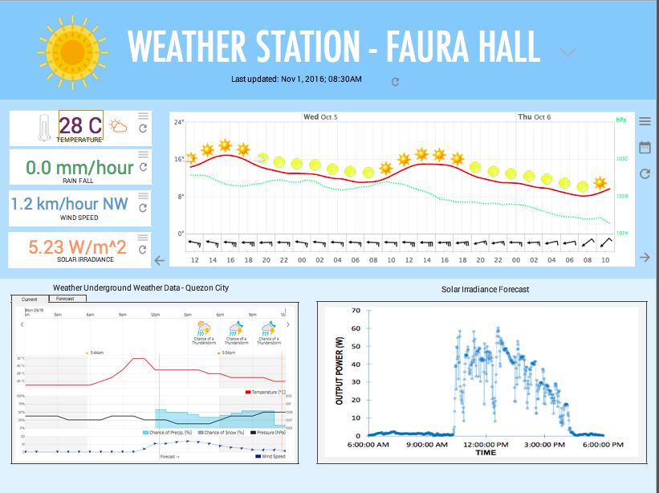
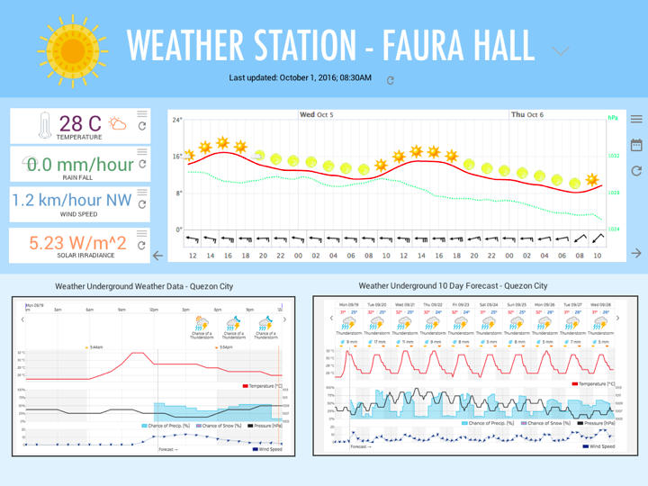
Data Visualization
Notes:
Palipat nito sa slide na may description nung calibration please ☺

Slide 55
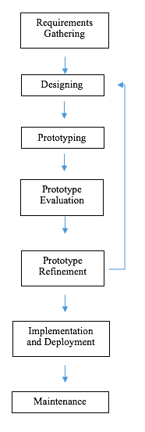
Data Visualization
Notes:
On the software side, the software development process (see Fig. 1) begins with requirements analysis, and stakeholder identification. Based on these parameters, a specific software development methodology can be identified that would enable a streamlined development process. In this study, the proponents, guided by the thesis advisers would serve as co-stakeholders for the project as the objectives defined will be the earmarks of the study’s feasibility. Prototyping involves the detailed definition of the requirements for the project, including all aspects involved (users, administrators, etc) in order to quantify the scope at the very beginning of the development process. Using these details, user stories are listed in order to facilitate the prioritized order of feature development. User stories can then be created into user cases that may create possible scenarios and interactions the user of the application can make. Prior to development, a wireframe will be designed depicting the intended contents of the initial system.

Slide 56
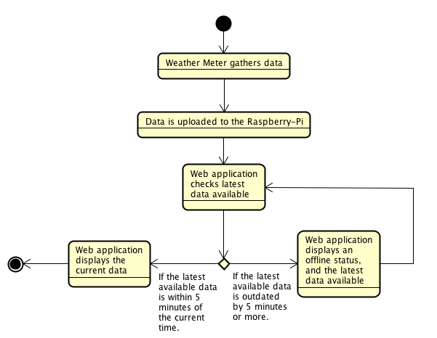
Data Visualization
Notes:
The proponents of this study will create a back-end setup in the server that accesses the R-Pi collecting the data. The data collected will be stored in a database with their respective timestamps for historical purposes. Prior to storage, the data collected from the weather meter will be post-processed for the standard unit conversion. The applications that are to be made, for both Weather Meter and Power Prediction, will access the respective databases for the data needed. Fig. 2 and Fig. 3 show the flow chart representation of what the applications do at face value for the users.
JavaScript will be used as both the front-end and back-end programming language as this provides frameworks for making real-time charts through interfacing with websockets.

Slide 57
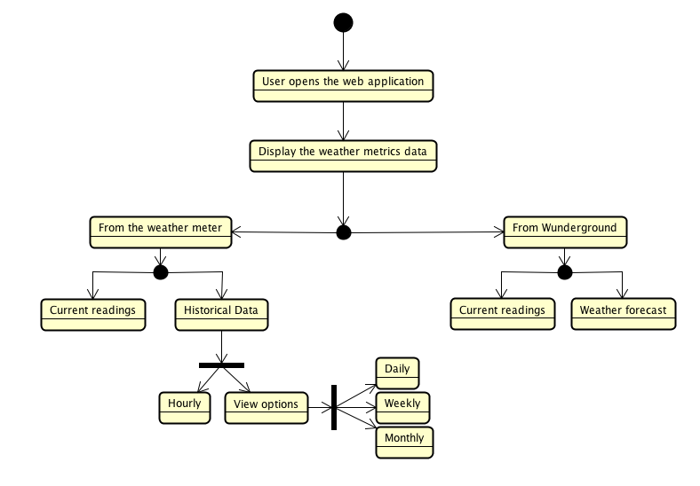
Data Visualization
Notes:
The proponents of this study will create a back-end setup in the server that accesses the R-Pi collecting the data. The data collected will be stored in a database with their respective timestamps for historical purposes. Prior to storage, the data collected from the weather meter will be post-processed for the standard unit conversion. The applications that are to be made, for both Weather Meter and Power Prediction, will access the respective databases for the data needed. Fig. 2 and Fig. 3 show the flow chart representation of what the applications do at face value for the users.
JavaScript will be used as both the front-end and back-end programming language as this provides frameworks for making real-time charts through interfacing with websockets.

Slide 58
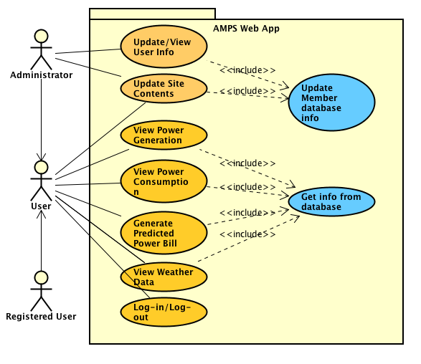

Slide 59
Use Case | Description
Log In | Allows an existing user to login New users are asked to register through a given link
View Power Generation | Shows power generation Requires the user to be logged in
View Power Consumption | Shows power consumption Requires the user to be logged in
Generate Predicted Power Bill | Shows predicted power bill Requires the user to be logged in
View Weather Data | Shows weather metrics Requires the user to be logged in
Update or View User Info | Allows updating of registered user’s contact information and password recovery View list of users Requires user to be logged in an be an administrator
Update Site Contents | Alter the data provided by the site Requires user to be logged in and to be an administrator
Log Out | Ends the user’s current session

Slide 60
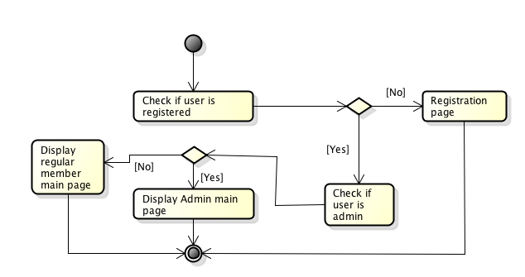

Slide 61
The Solar Solution
Solar power as a means to provide electricity with minimal environmental effects
The Phillippine Setting:
San Carlos Plant – 80 GWH
Catalagan Solar Farm – 200,000 solar panels, 160-ha, 63.3 MW
Solaric and United Solar have residential solar panels installations
Notes:
Good afternoon, everyone. I am Rizzah Llanes and this is Julius Sambo and we are here to present our thesis proposal entitled “Application Design for Data Visualization in a Real-Time Power Prediction System with Weather Metrics Integration.”
The Philippines is developing in terms of technological innovations, and environmental studies. These studies aim to improve the living conditions of the Filipino people. Among these promising fields is the utilization and innovation of solar energy to provide electricity with minimal harm on the environment. Solar power plants and Photovoltaic Systems have already been built to contribute to the grid like the power plant found in San Carlos, Negros Occidental which provides 80 gigawatts hours per year to the Visayas grid or the Catalagan Solar Farm which has 200,000 solar panels and currently provides 63.3 megawatts to the entire western Batangas area. Private companies like Solaric and United Solar are also providing solar panels installations for residential use.

Slide 62
Weather and Solar Power Generation
Meteorological conditions affect the solar panel’s power generation.
Various parameters like irradiance, pressure and temperature may contribute or hinder the panel from absorbing solar energy.
Studies and algorithms have been designed for predicting the power generated in relation to the changes of the weather.
Notes:
Despite these developments, a lot of uncontrollable factors still affect the power generation of the solar panels and one of these is meteorological condition. Various parameters like irradiance, pressure and temperature may contribute or hinder the panel from absorbing solar energy. In response to this problem, studies and algorithms have been designed for predicting the power generated in relation to the changes in the weather. Some examples of these studies will be cited and discussed later.

